Slide 1
CAFES IN ISTANBUL
Ergin Ozcan

Slide 2
THIS PROJECT IS DEDICATED TO…
Potential coffee business planners
Fans interests

Slide 3
DATA ACQUISITION AND CLEANING
I used Foursquare API for this Project. Because they contains several places from district to district.
Unfortunately, I can’t used delete data section. Because all known codes are not working in these data sets. «I did wrong in somewhere but I do not what is the wrong.»
Too much data is bored to researchers and fans. So I select 12 areas and I Show some areas.

Slide 4

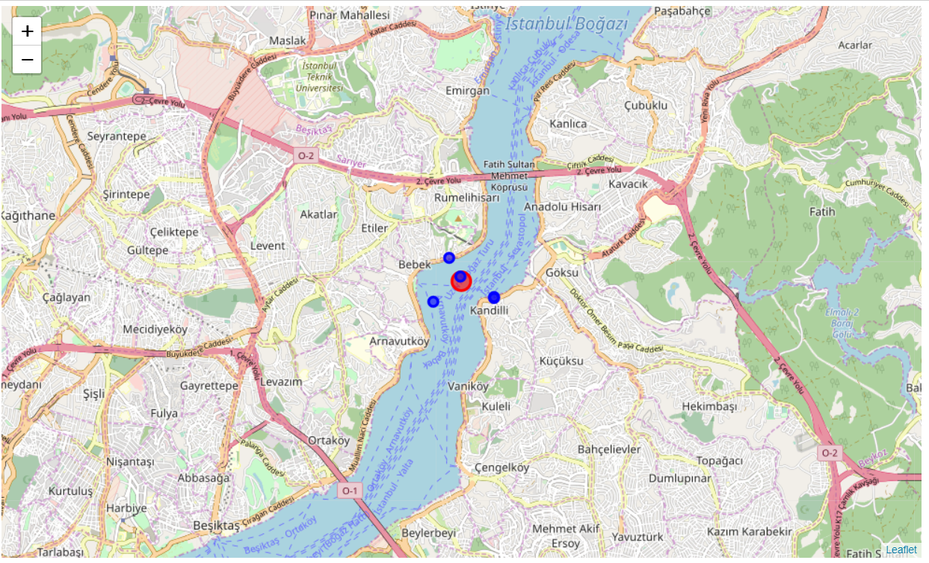
ISTANBUL AREA (IN THE MIDDLE)

Slide 5
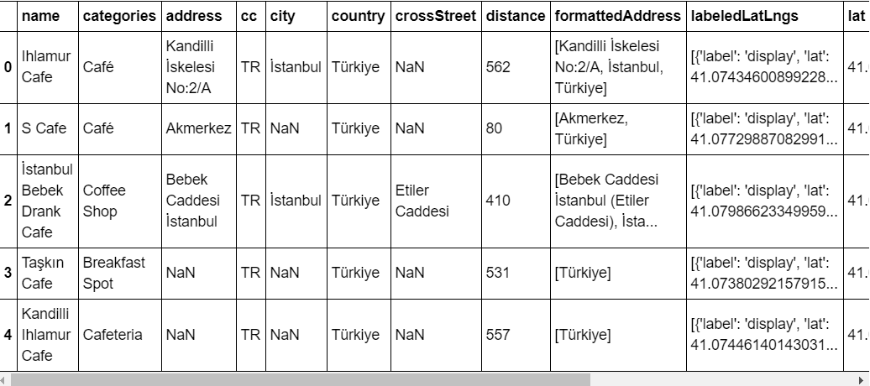
In the look at this result, you see only five results. Although, if you see list, you see only three of five results are located to «café».

Slide 6
IN THIS PROJECT
We show
Yeniköy
Büyükada
Tuzla
Şile
Beşiktaş / Bebek / Ortakoy
Moda, Kadikoy
Nisantasi
Beylikduzu

Slide 7
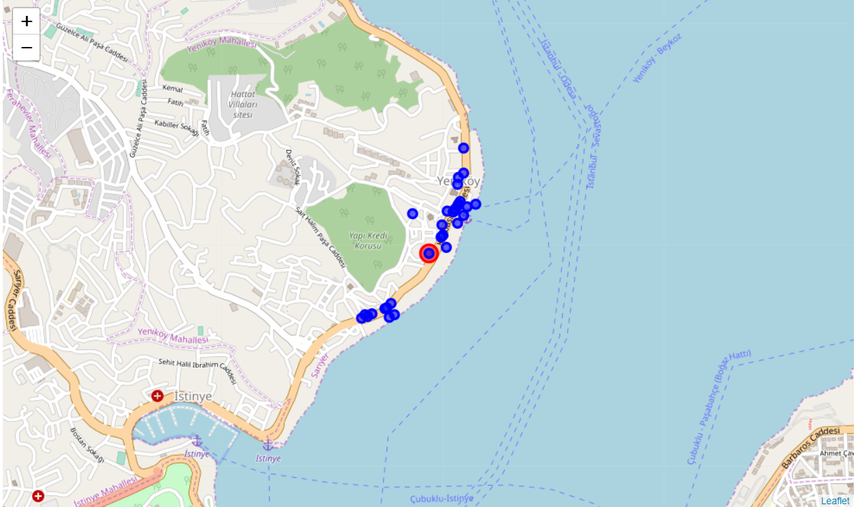
YENIKOY
Only 15 cafés still active. Remain of the list are working other areas.
Sedona Concept and Yeniköy Kitapçısı are popular in this area.

Slide 8
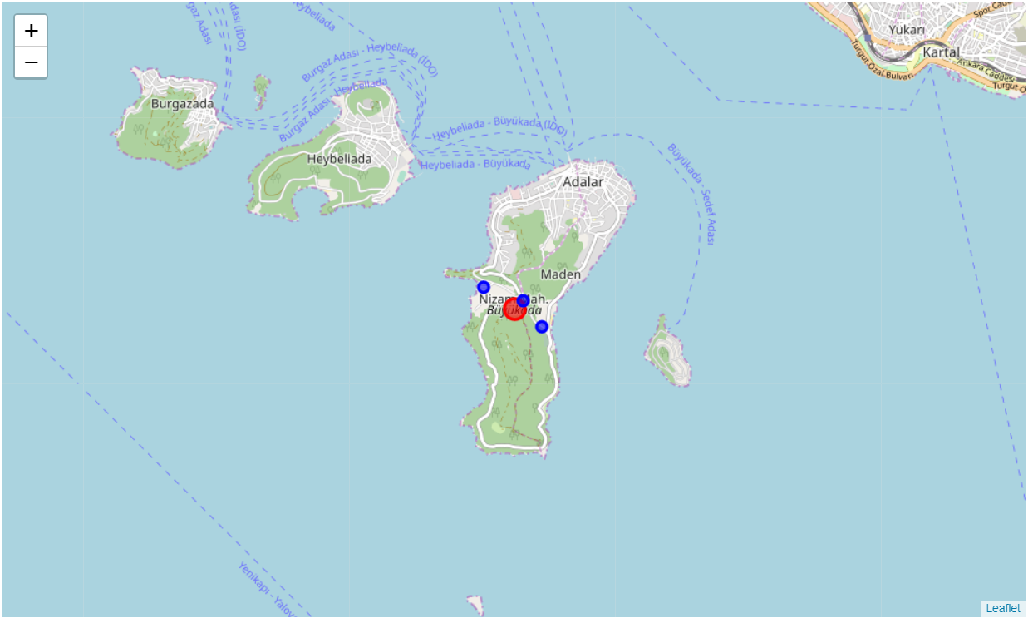
BUYUKADA
Only three cafés are available in Buyukada.
Rent prices are main difficulty in this island.
Heybeliada have more cafés than Buyukada.

Slide 9
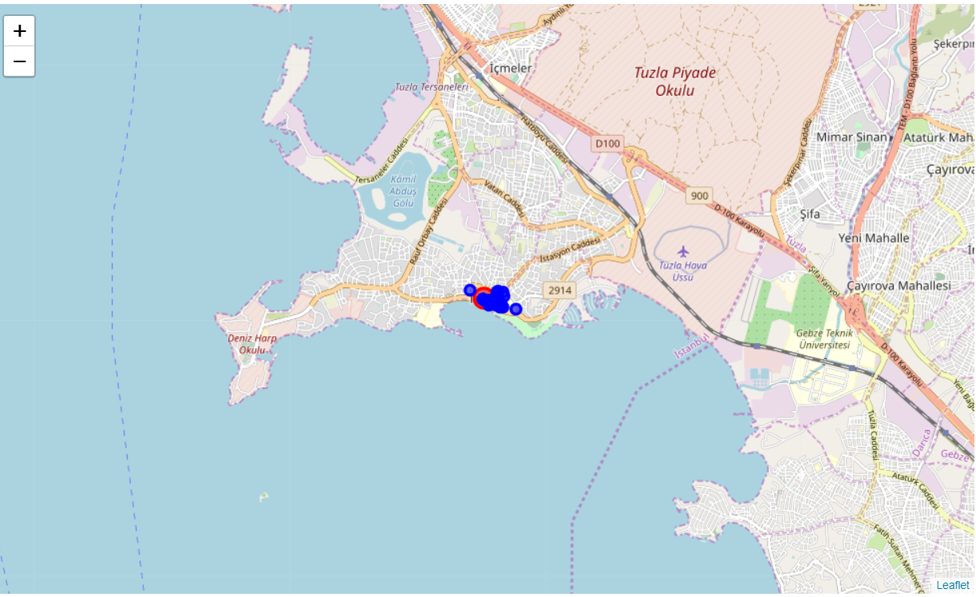
TUZLA
Cafés are mainly located at Ahmet Gunes Boulevard. ITU Students are main audience in these cafés.
Tuzla also have Viaport Marina. They have many coffee station.

Slide 10
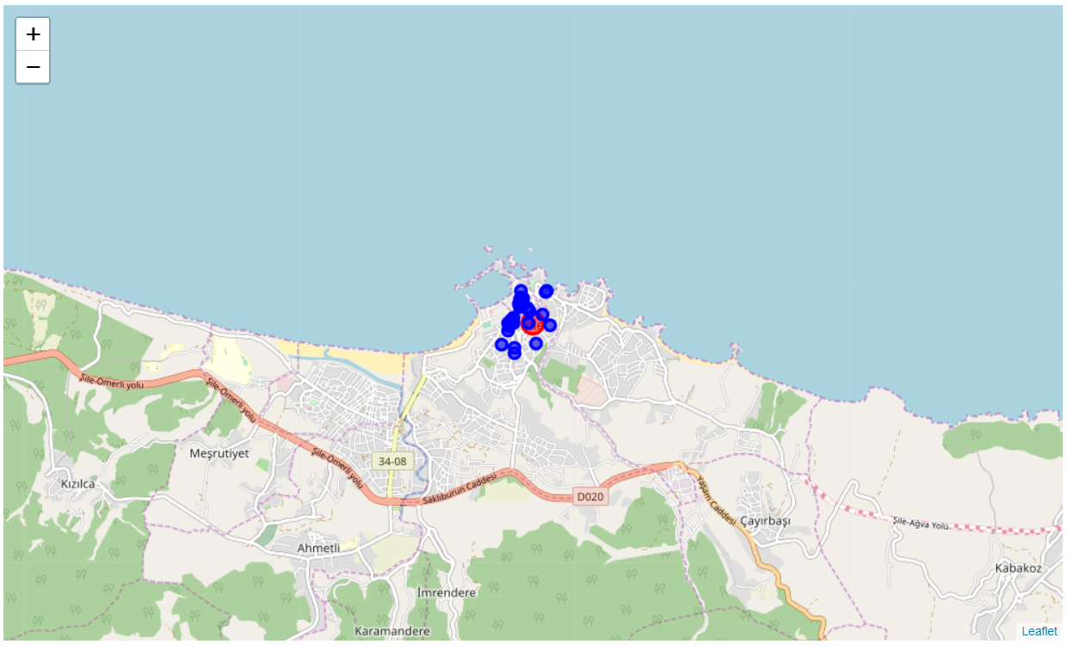
SILE / ISTANBUL
In Sile, cafés are widely available. Although, some internet cafés are included in this list but mainly this area got competitive in the this sector.

Slide 11
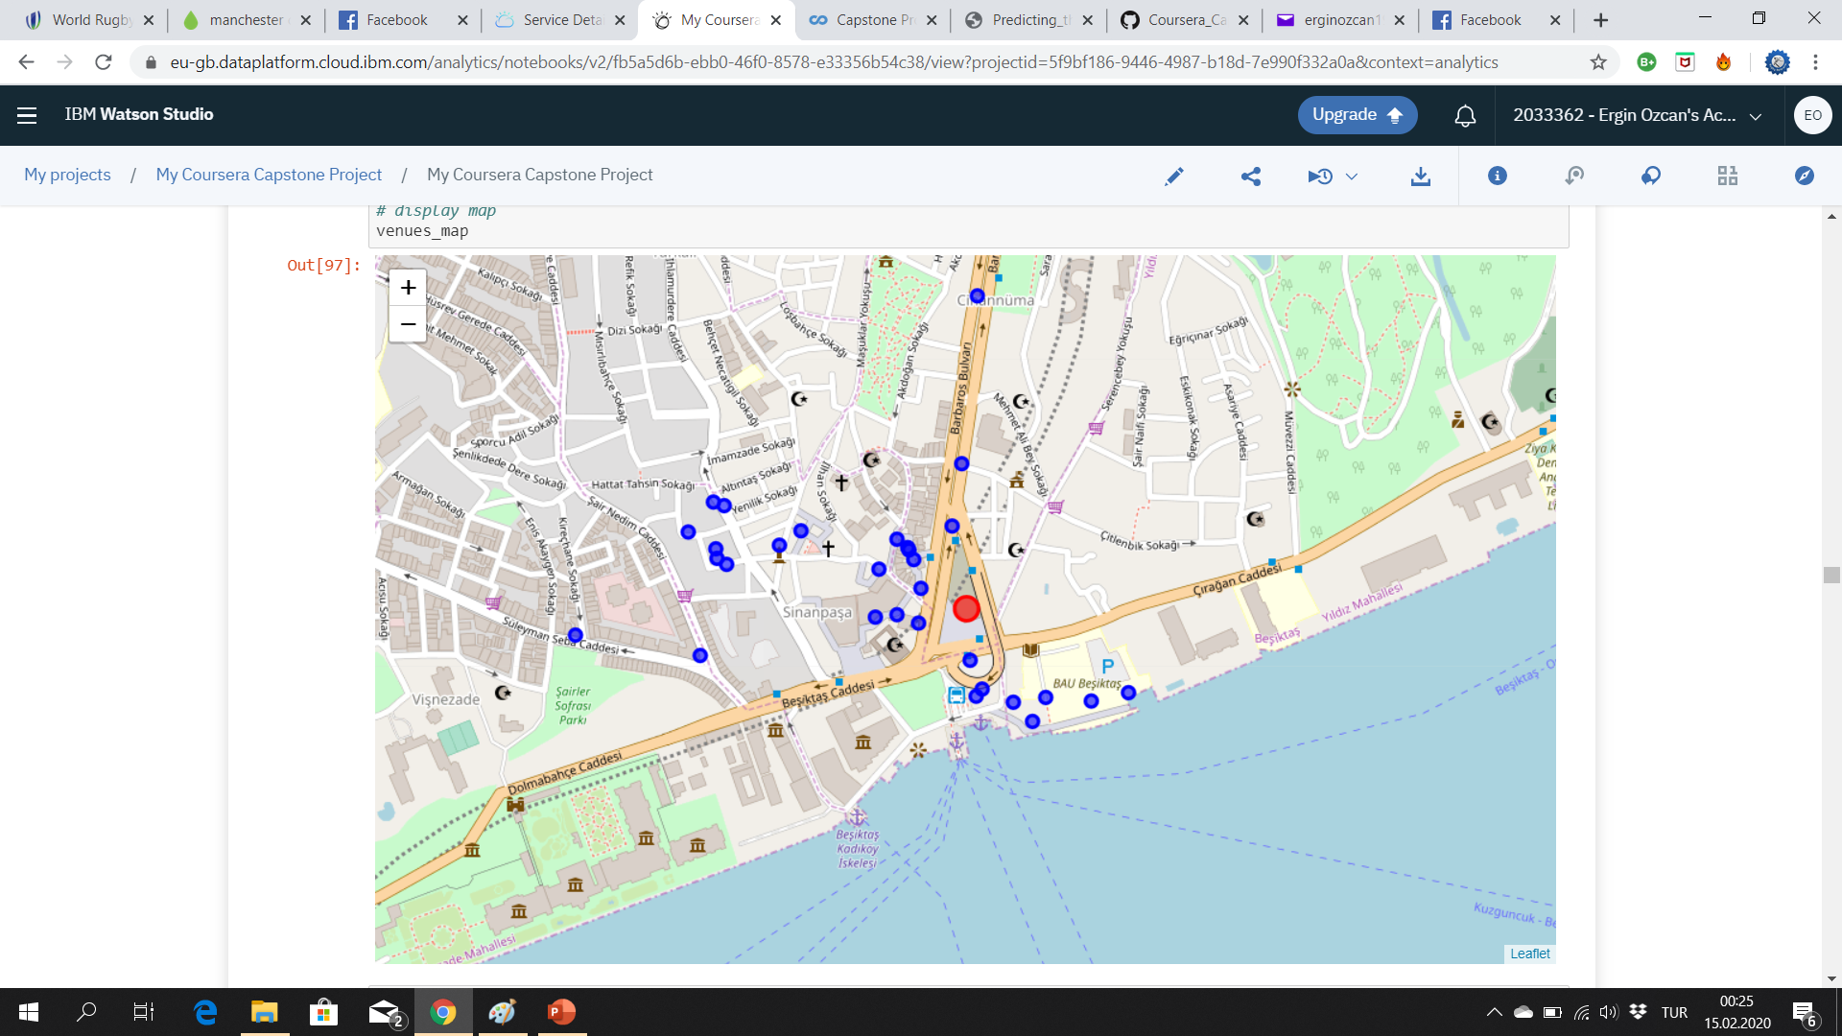
BESIKTAS maın sıde

Slide 12
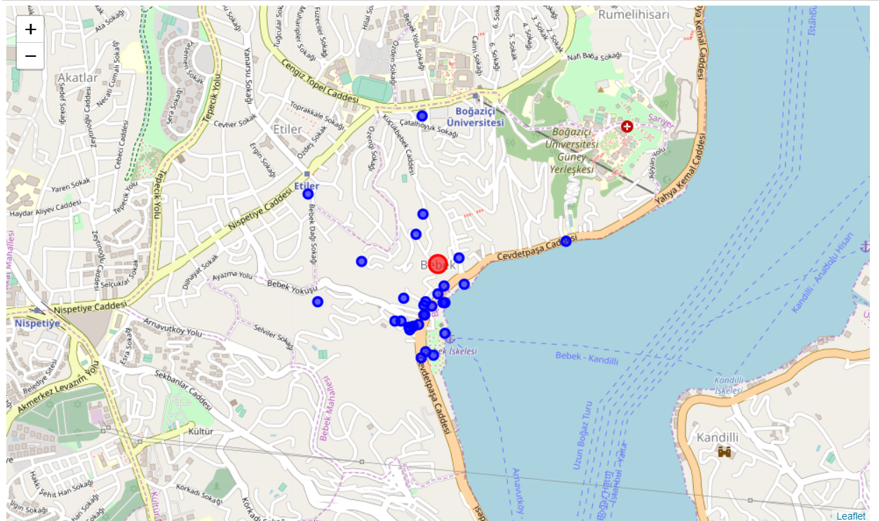
BEBEK / ISTANBUL

Slide 13
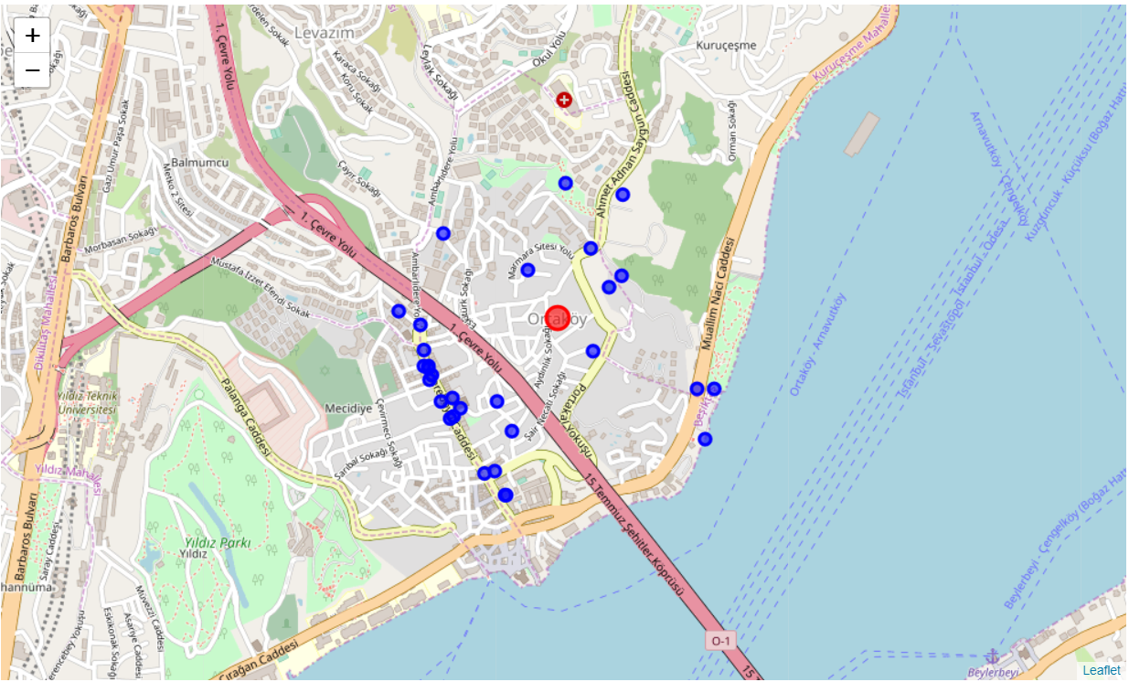
ORTAKÖY

Slide 14
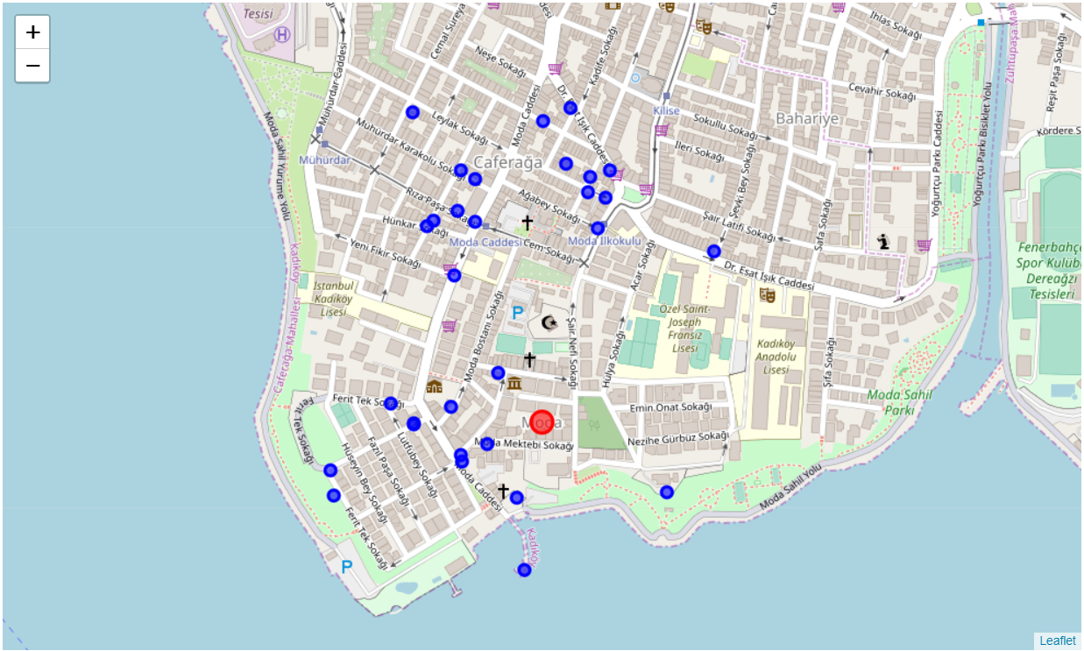
MODA ISTANBUL
Moda is home of the «café» in Istanbul. They have many cafes which are very trusted and very popular.
Doz Kadıköy, Walter’s Roastery Coffee and Kronotrop is popular in Moda.
In neighbor, Kadikoy Carsi have very tough rivals such as Viyana Kahvecisi, Starbucks and Montag.

Slide 15
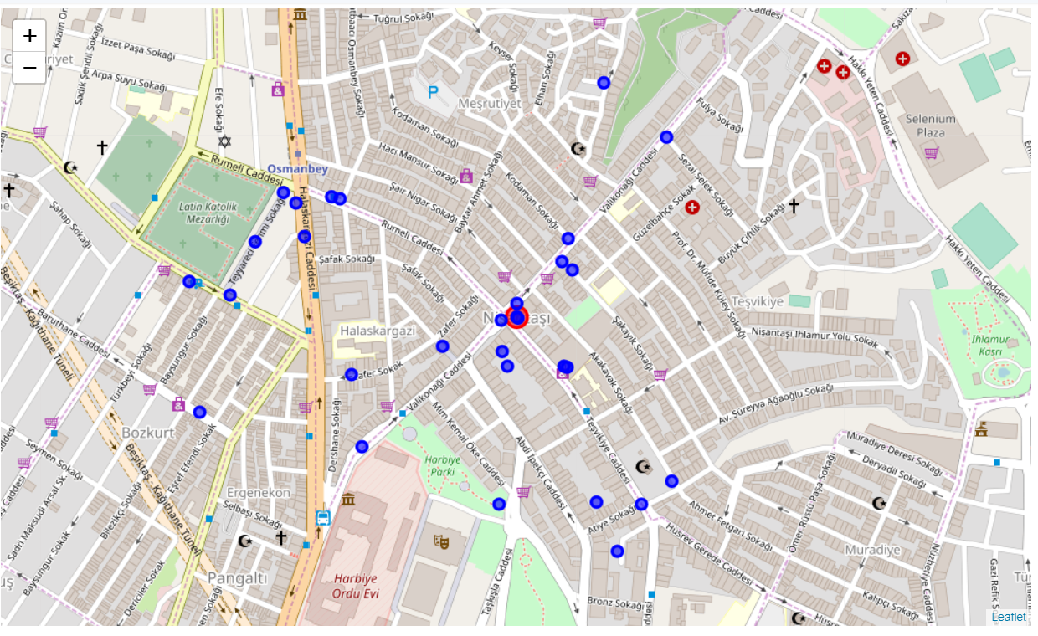
NISANTASI / ISTANBUL
In Nisantasi, they got great names about coffee. Outside of great coffee companies, MOC is most popular in the third-wave coffee and they use different menus. Other cafés wants to popular as same as MOC and Starbucks Reserve.

Slide 16
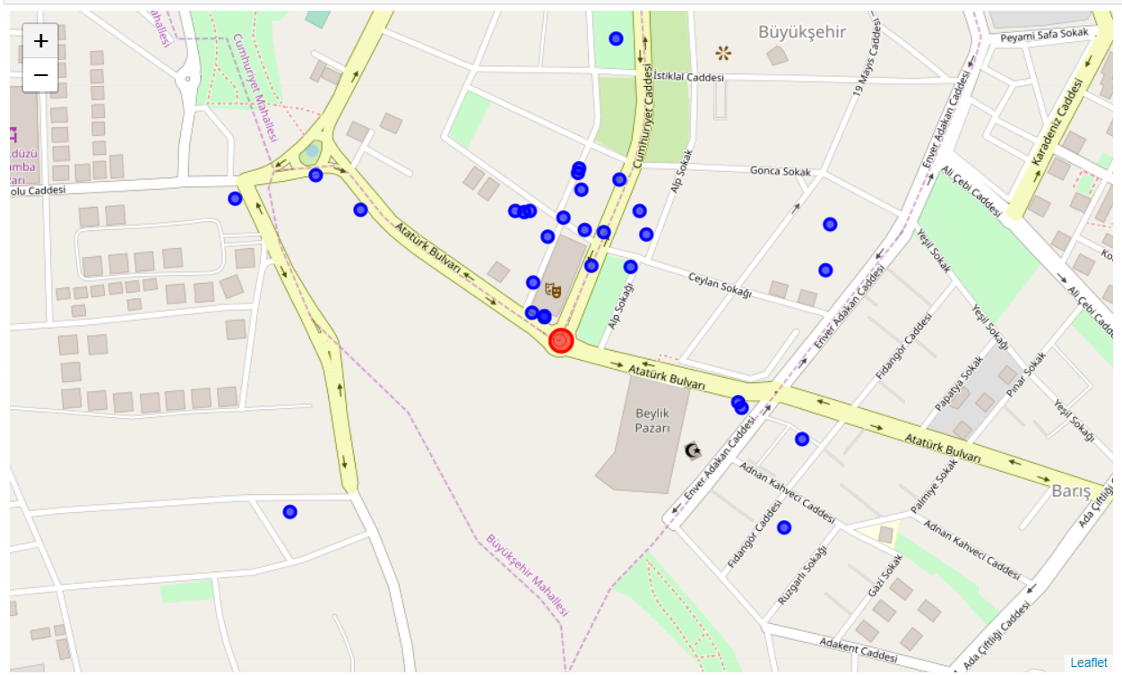
BEYLIKDUZU / ISTANBUL
Beylikduzu is developing district at social activities in Istanbul. Several cafes are launched last year in Beylikduzu and they attracts people in nowadays. Maybe they are less popular than Sisli, Besiktas and Kadikoy. Although, they have a potential. Gurpinar is the beach of Beylikduzu and they got many cafes. Although, Gurpinar is less developed than Beylikduzu by the transport difficulty.

Slide 17
CONCLUSION
District-to-District maps
Café density

